Slide 1
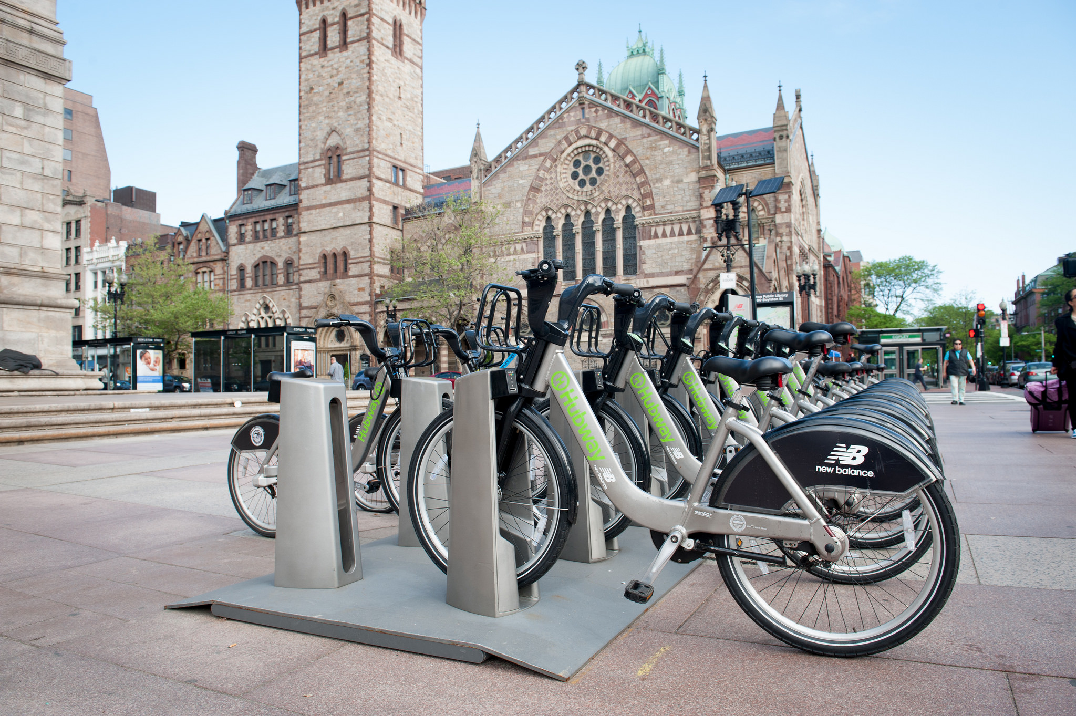


Slide 2

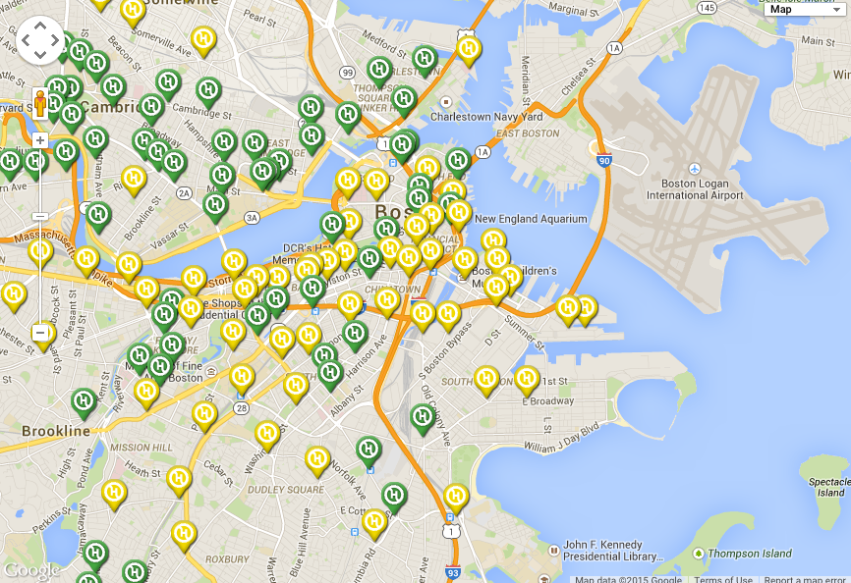
Market
SOMERVILLE
CAMBRIDGE
BOSTON
BROOKLINE
Source: www.bostonmagazine.com/news/2015/04/30/hubway-locations

Slide 3
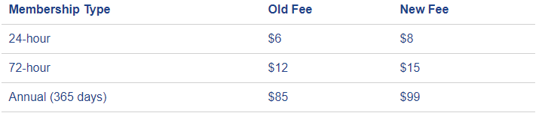
Membership
Source: www.bluebikes.com/pricing

